Slide 1

An internship mid-term defense on
Wind Horse Tours
Bsc.csit, 8th Semester

Slide 2


Slide 3

Halftone designs pvt. Ltd.
Provide services regarding graphic design, website designing, development and maintenance.
Founded in 2011.
Location – Dillibazaar, Kathmandu.

Slide 4

Wind horse tours
Tours, treks and travel operating company.
Officially launched in 1998 in Bhutan.
Operates trek and tour in Nepal, India, Bhutan, Tibet, Sikkim and Darjeeling.

Slide 5

Problem Statement
Absence of live website.
Reservation, Payment problem etc.

Slide 6

internship Objectives
To experience and understand the work ethics, professional standard and technology used by an organization to achieve their goals.
To get knowledge and experience in handling real world project.

Slide 7
Project Objectives
To bring the company profile online.
To facilitate people with the services of reservation, payment and checking the availability of trips, tours and treks online.
To make the web application responsive using fluid grids, fluid images and media query.

Slide 8
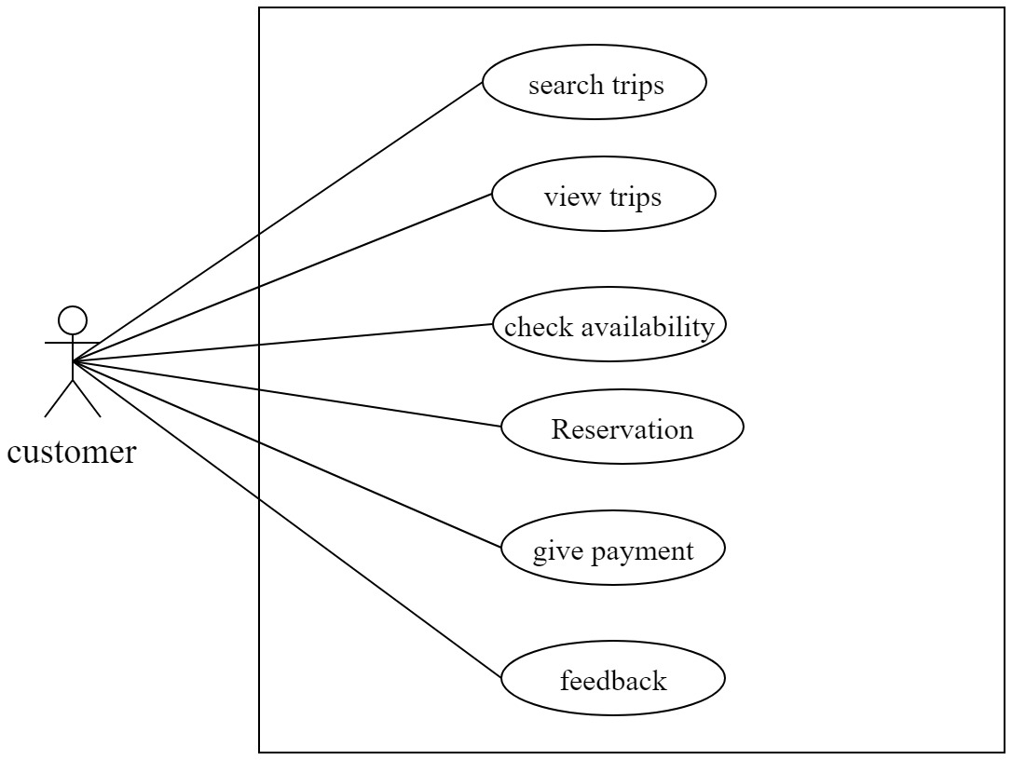
Use case diagram

Slide 9
Non-Functional requirement
The web application should load and response fastly.
The web application should be scalable.
The web application should be available all the time.
There should be the security of the communication between the use and the system.

Slide 10
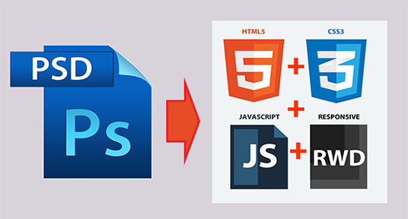
Psd to html conversion

Slide 11
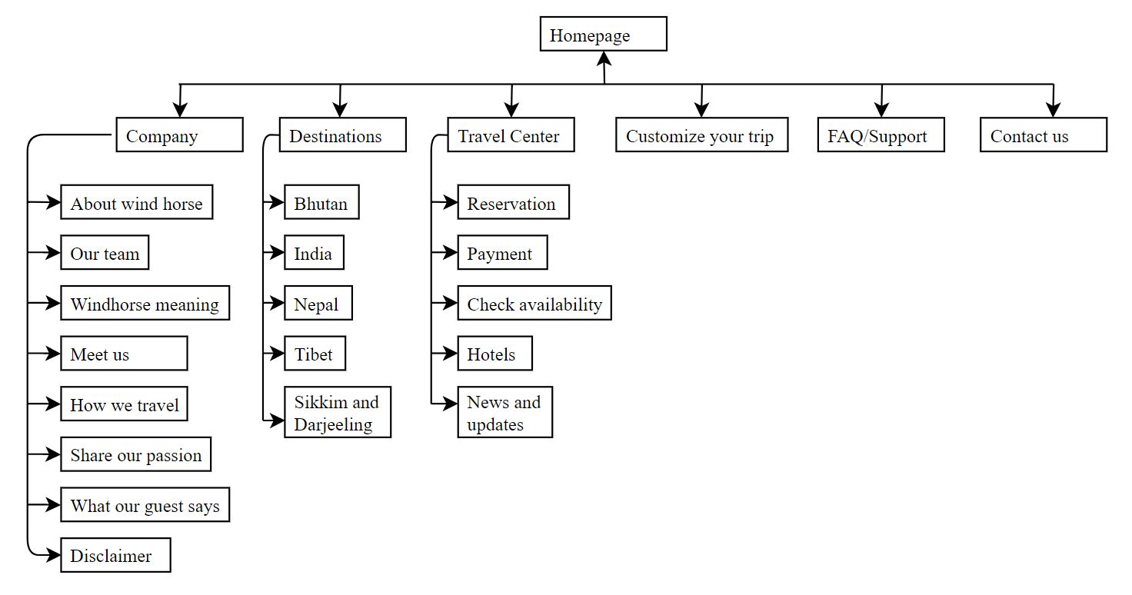
WEBSITE STRUCTURE

Slide 12






IMPLEMENTATION
Photoshop cc 2017
Sublime Text 3
Html5
Css3
Jquery
Apache

Slide 13

Testing
Code validation
Cross browser testing
Responsive Design testing

Slide 14

Code validation
Html5 validation: https://validator.w3.org/

Slide 15

Code validation
CSS validation: https://jigsaw.w3.org/css-validator/

Slide 16

Cross browser testing
Ability for a website, web application, html construct or client side script to support all the web browser.

Slide 17

Responsive design test
Google Chrome’s Devtools feature: device mode

Slide 18
conclusion
Conversion of PSD template of wind horse tours to html5/css3 is completed.
Responsive design has been implemented.
Code validation, cross browser testing is completed.

Slide 19
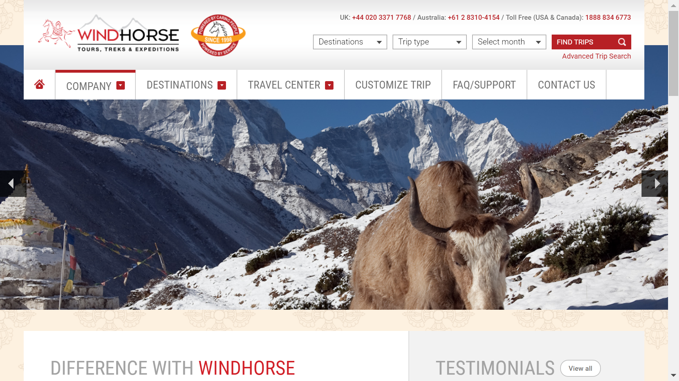
screenshots

Slide 20
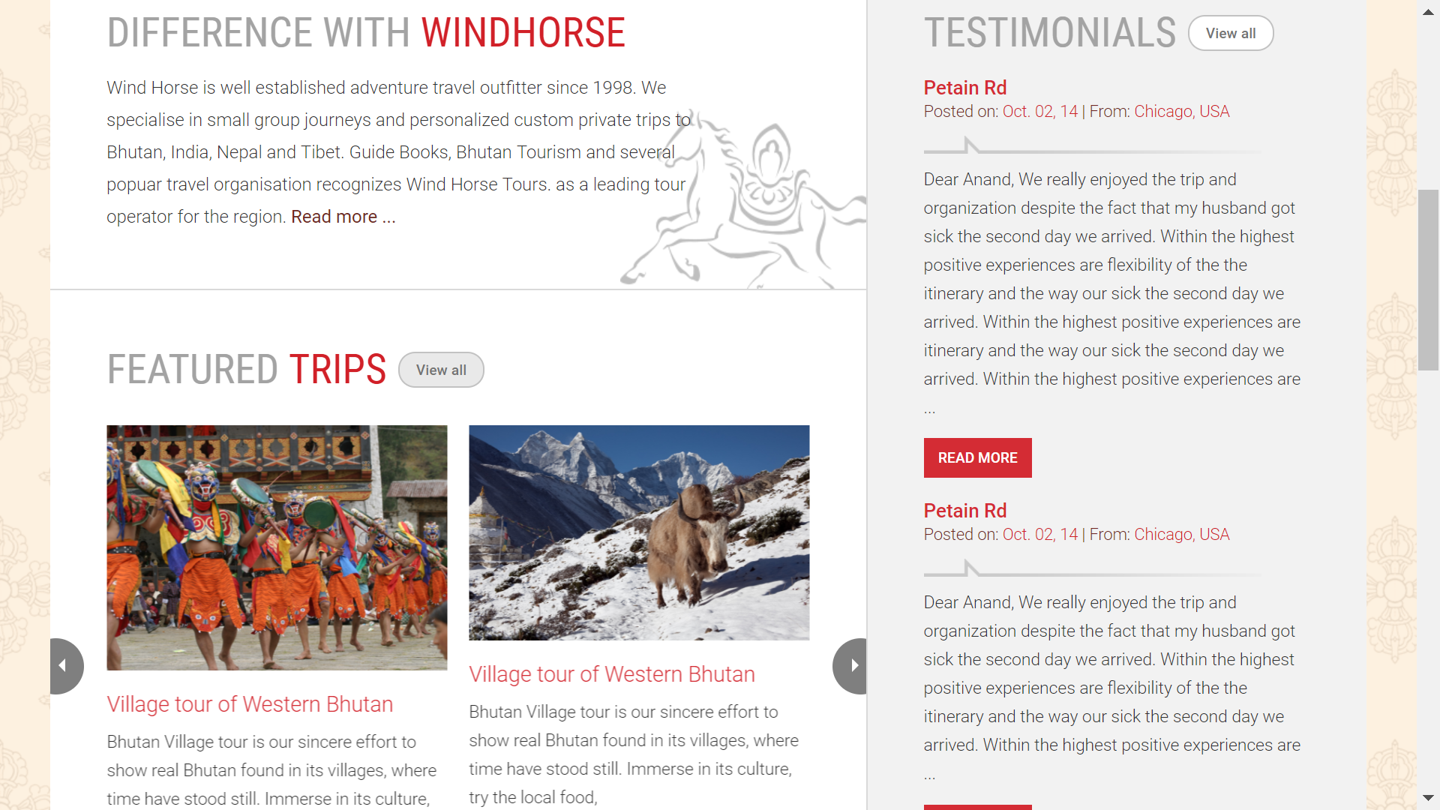
screenshots

Slide 21
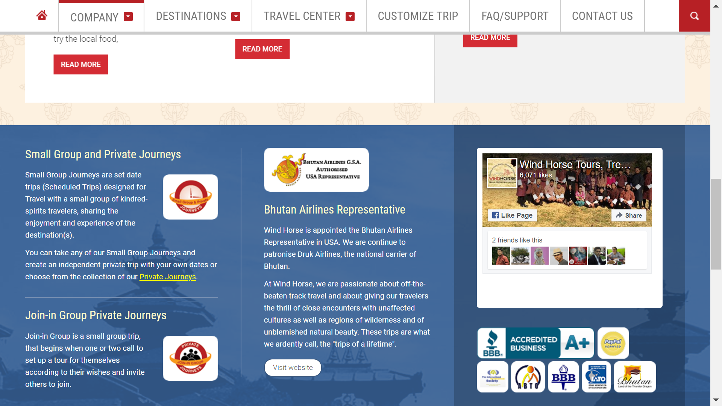
screenshots

Slide 22
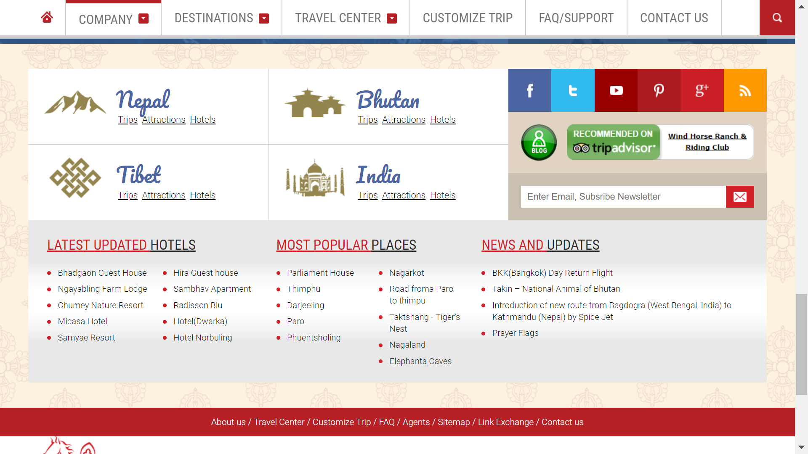
screenshots

Slide 23
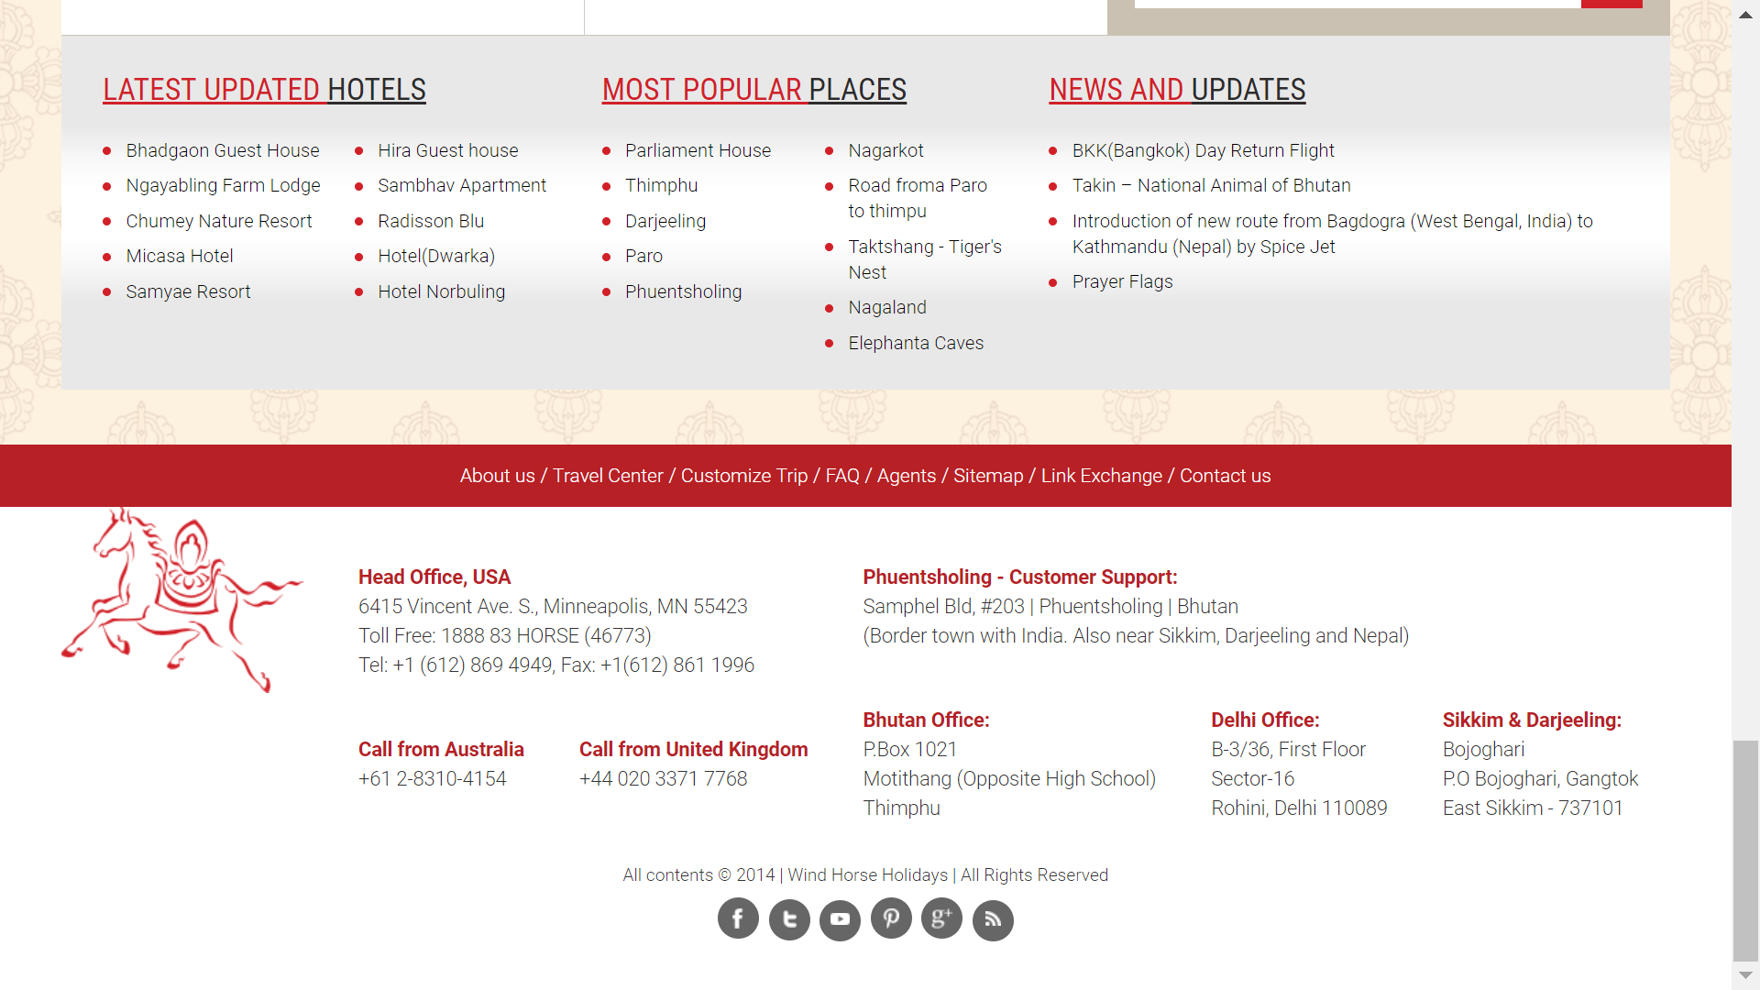
screenshots

Slide 24
Thank you!!

